Slide 1
REPORTLAB PYTHON COMPLETE TUTORIAL
TextObject setWordSpace()
Tutorial 14

Slide 2
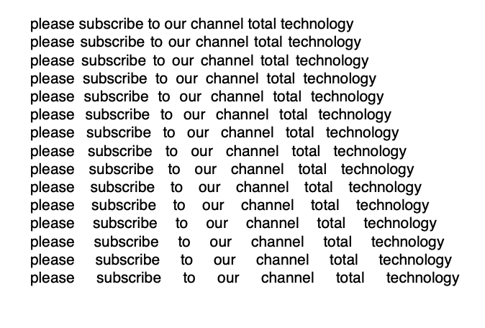
setWordSpace()
Change spacing between the words dynamically
In this his example the task pretty much the same as the previous one, but we will notice that we are calling setWordSpace() instead of setCharSpace() and we are increasing the spacing by a dynamic factor.
Sample out put:

Slide 3
setWordSpace()
Change spacing between the words dynamically
In this his example the task pretty much the same as the previous one, but we will notice that we are calling setWordSpace() instead of setCharSpace() and we are increasing the spacing of the words by a dynamic factor.
Code:
#tutorial 14
#textobject word spacing
from reportlab.pdfgen import canvas
from reportlab.lib.units import cm
pdf=canvas.Canvas("tutorial14.pdf",bottomup=0)
pdf.translate(cm, cm)
textobject=pdf.beginText()
textobject.setTextOrigin(10, 10)
text="please subscribe to our channel total technology"

Slide 4
setWordSpace()
Change spacing between the words dynamically
In this his example the task pretty much the same as the previous one, but we will notice that we are calling setWordSpace() instead of setCharSpace() and we are increasing the spacing of the words by a dynamic factor.
Code:
for i in range(15):
textobject.textLine(text)
textobject.setWordSpace(i+1)
pdf.drawText(textobject)
pdf.save()

